Slide 1


Center of Excellence for
Building Decarbonization (CEBD)
Decarbonization:
Retrofitting Buildings,
Reducing Emissions

Slide 2

Agenda
Introduction
Moving Towards a Low Carbon Future
Exploring Technologies
Alternatives
Challenges
ASHRAE Update

Slide 3

Notes:
Nature is beautiful.
This forest embodies an efficient, self-sustaining system where nothing goes to waste.
Fallen leaves decompose and enrich the soil, supporting new plant growth and maintaining a balanced ecosystem.
This cycle is sustainable; it supports biodiversity and regulates ecological balance without external inputs.
Nature also uses renewable energy.

Slide 4
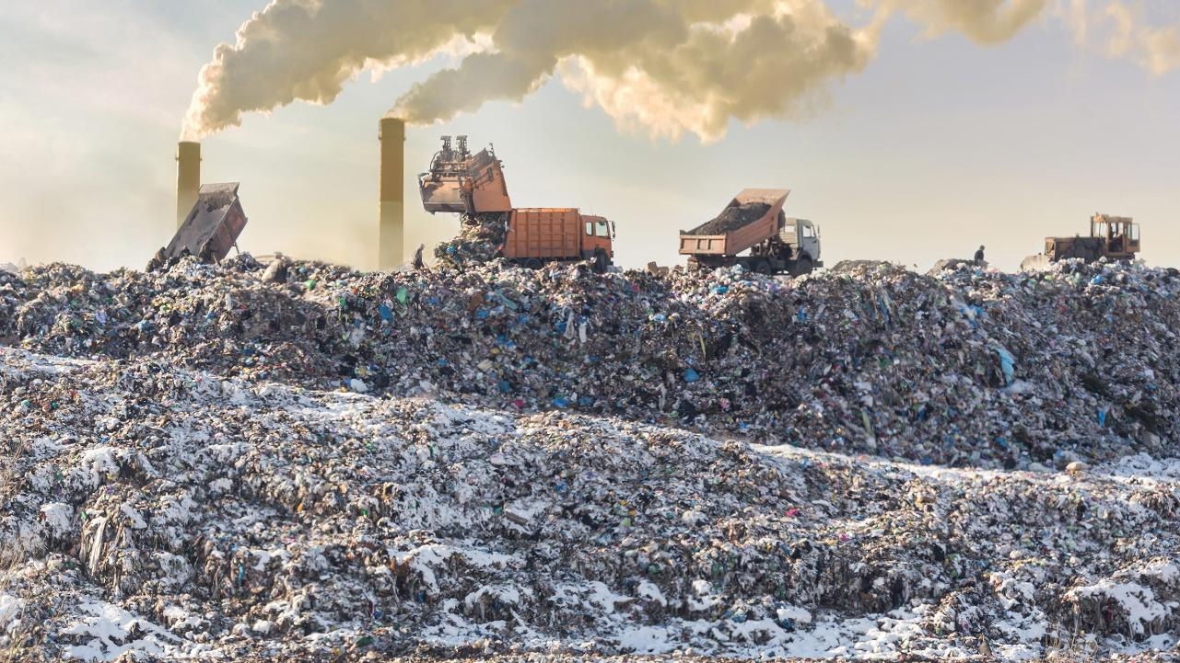
Notes:
We are all mostly intelligent lifeforms. We create order out of chaos.
The order we create is not reversible and not 100% efficient.
Talking Points:
Landfills are a standard method for managing human-generated waste, highlighting the scale and permanence of waste accumulation.
The negative impacts of landfills include soil and water contamination, methane emissions (a potent greenhouse gas), and the loss of usable land.
Many materials in landfills could be recycled or reused, pointing out missed opportunities for more sustainable resource management.

Slide 5
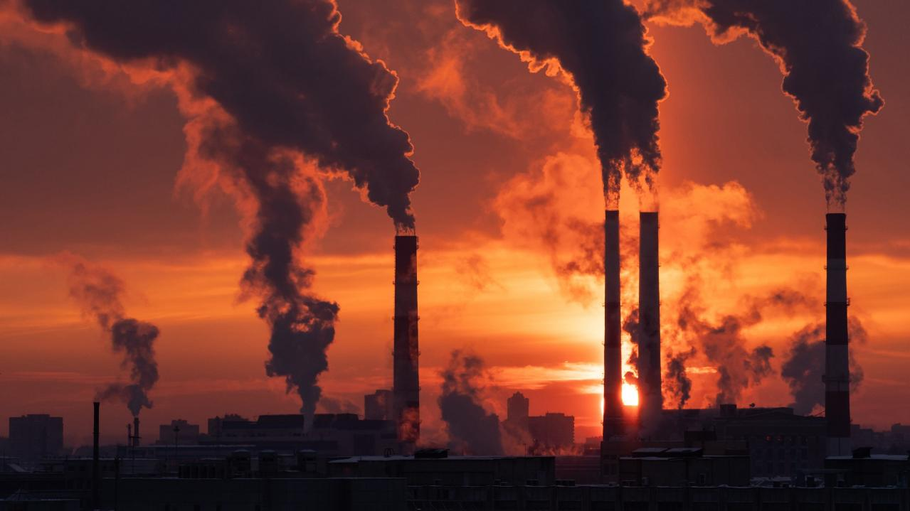
Notes:
We have done a great job of figuring out how to use our natural resources to improve our lives.
The challenge has been the growing population and whether our past ways will serve a population of 10 billion people
Without harming the environment we must live in.

Slide 6





Slide 7
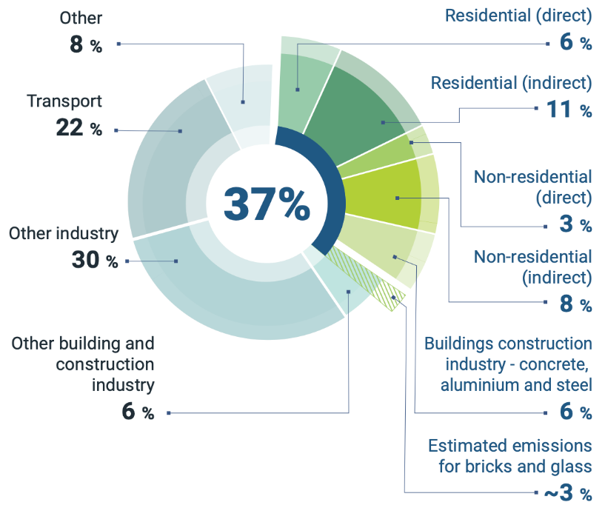
Global building sector energy-related CO₂ emissions,
2021
Source: IEA 2022. All rights reserved. Adapted from "Tracking Clean Energy Progress" (IEA 2022f). https://www.unep.org/resources/publication/2022-global-status-report-buildings-and-construction

Slide 8

ASHRAE’s position…
Eliminating GHG emissions from the built environment is essential to address climate change
Notes:
ASHRAE’s position is simple. Eliminating GHG emissions from the built environment is essential to address climate change.

Slide 9
ASHRAE goals…
2030
The global built environment must halve its 2015 GHG emissions
All new buildings must be NZE
Widespread EE retrofits of existing assets
New construction embodied carbon must be reduced by at least 40%
2050
All new and existing assets must be net zero GHG emissions across the whole life cycle
Notes:
By 2030, the global built environment must halve its 2015 GHG emissions, whereby
all new buildings must be net zero GHG emissions in operation,
widespread energy-efficiency retrofits of existing assets must be well underway, and
embodied carbon of new construction must be reduced by at least 40%.
By 2050, at the latest, all new and existing assets must be net zero GHG emissions across the whole life cycle.

Slide 10

Understanding
Beneficial
Electrification

Slide 11
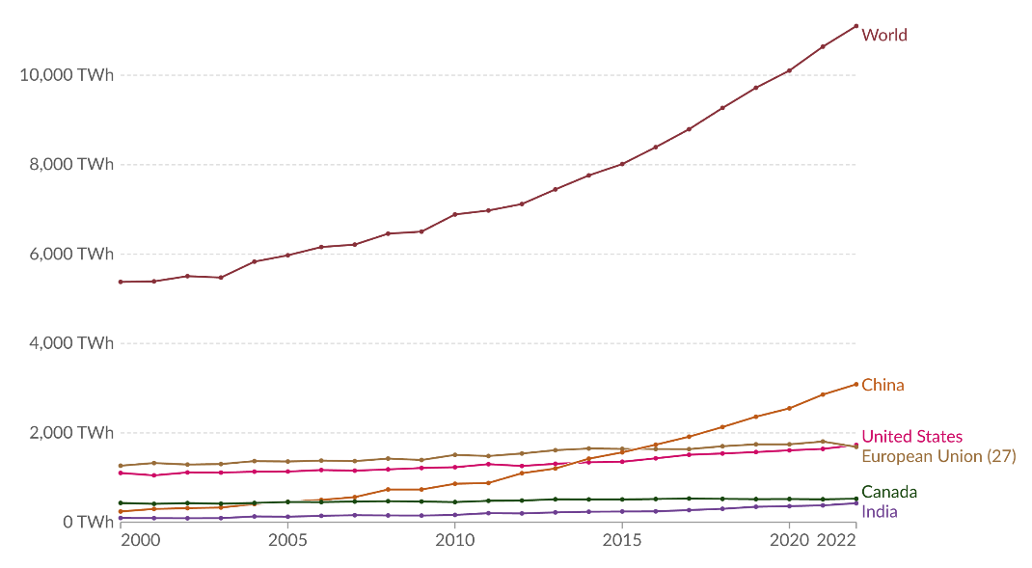
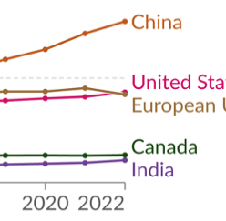
Electricity generation from low-carbon sources, 2000 to 2022
Low-carbon electricity is the sum of electricity generation from nuclear and renewable sources
Source: Ember - Ember - Yearly Electricity Data (2023); Ember - European Electricity Review (2022); Energy Institute - Statistical Review of World Energy (2023), OurWorldInData.org/energy
Notes:
Low-carbon electricity sources will be essential to reduce indirect GHG emissions from the building sector.
Low-carbon electricity can come from nuclear or renewable sources such as hydropower, solar, wind, and geothermal.
The contribution of each varies from country to country.
Globally, 39% of our electricity came from low-carbon sources in 2020.
But there is a lot of variation in low-carbon electricity production worldwide.
World electricity generation has added roughly 5700 TW of low-carbon electricity generation since 2000,
increasing it by 106% in the past 22 years.
China accounted for roughly half of the global low-carbon electricity generation growth during that period.
China is set to quintuple its renewable energy installations by 2050,
shift its power mix from 30% renewables today to 88% by mid-century,
in less than a decade has increased its solar power generation from 1 to 5%, but this will increase to 38% of electricity production by 2050.
They will reduce annual emissions by 8Gt between now and 2050, which is three times as much as Europe’s emissions reductions.

Slide 12
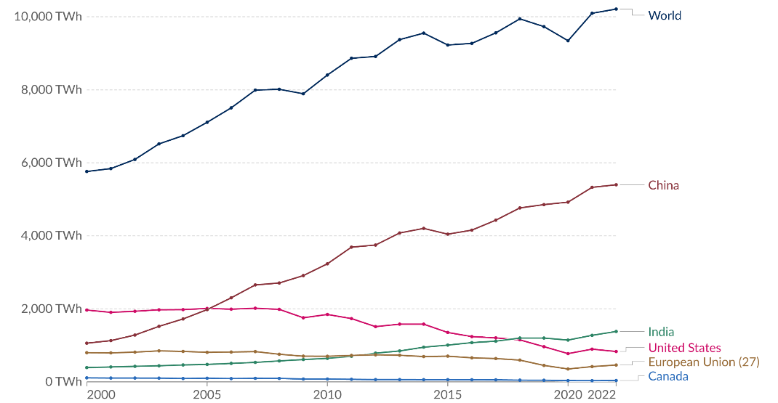
Electricity generation from coal, 2000 to 2022
Measured in terawatt-hours
Source: Ember - Ember - Yearly Electricity Data (2023); Ember - European Electricity Review (2022); Energy Institute - Statistical Review of World Energy (2023), OurWorldInData.org/energy
Notes:
We will need to figure out how to substantially reduce emissions from the world’s reliance on electricity generation from coal.
As we look for solutions, it is important to understand why we have relied on coal in the past.
Coal has been a reliable and affordable energy source. It is abundant and easy to extract and relatively inexpensive to transport.
Additionally, it is a very efficient fuel source, meaning that a large amount of energy can be produced from a small amount of coal.
As we look to reduce GHG emissions, coal generation produces more than double the GHG
emissions when compared to combined cycle natural gas generation.
World electricity generation added roughly 4450 TW of coal electricity since 2000.
Many countries have decreased their coal generation during this period.
China’s growing economy added roughly 5600 TW of coal generation since 2000,
slightly more than the amount of low-carbon generation they added during the same timeframe.

Slide 13
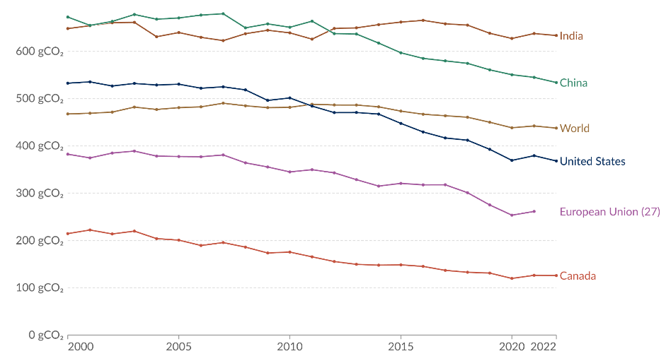
Carbon intensity of electricity, 2000 to 2022
Carbon intensity is measured in grams of carbon dioxide-equivalents emitted per kilowatt-hour of electricity
226 gCO₂e
NG boiler
80% eff
Source: Ember - Yearly Electricity Data (2023); Ember - European Electricity Review (2022); Energy Institute - Statistical Review of World Energy (2023)
OurWorldInData.org/energy
Source: EPA Emission Factors for Greenhouse Gas Inventories
Notes:
Carbon intensity on this chart is shown in grams of carbon dioxide-equivalents emitted per kilowatt-hour of electricity generated.
The electric grid carbon intensity has been trending downward since 2010 in many parts of the world.
Much of the reduction is due to the rapid increase of low-carbon generation and natural gas generation replacing coal generation.
Economics will continue to play a critical role in the overall solution sets as we transition towards low-carbon generation.
The energy around the globe must be accessible and affordable.
<click> The GHG carbon intensity from an 80% efficient natural gas boiler is shown. This is gCO2/kWh of output.
<click> The boiler’s actual annual operating efficiency is closer to 70% when accounting for off-standard stack losses.
The electric grid carbon intensity values typically increase by 5% to account for the electrical distribution system losses to the building.
This is why efficient electrification of heat loads will be required using heat pump technology.
A heat pump with an operational COP of 2.0 or 200% efficiency would cut the electricity carbon intensity in half per kWh of heating
Electric resistance technology would generate more emissions than natural gas boilers in many areas of the world.

Slide 14
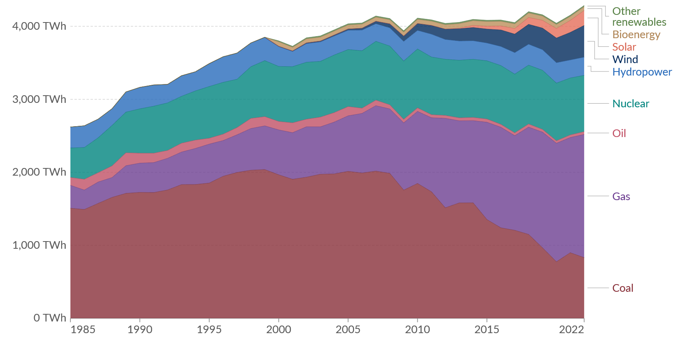
Electricity production by source, United States
Measured in terawatt-hours
Low carbon
Fossil fuel
Source: Ember - Yearly Electricity Data (2023); Ember - European Electricity Review (2022); Energy Institute - Statistical Review of World Energy (2023)
OurWorldInData.org/energy

Slide 15
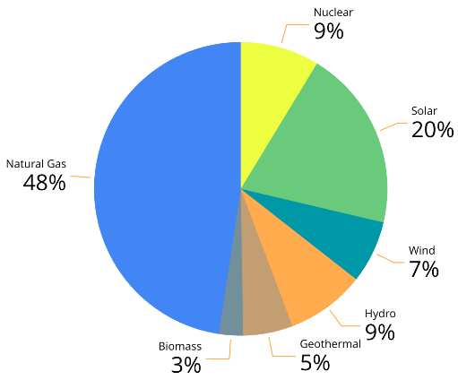
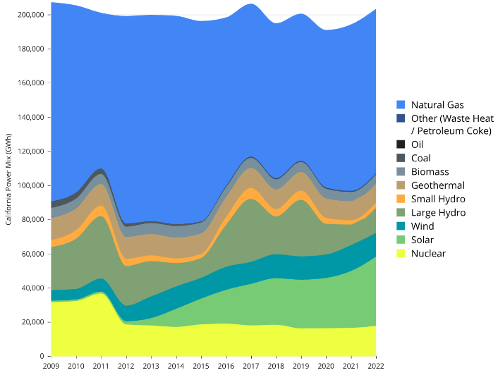
California Power Mix, 2009 to 2022
2022 California Power Mix
Source: https://www.energy.ca.gov/sites/default/files/2023-10/California_Electrical_Energy_Generation_2001-Current_ADA%20%28for%20web%29.xlsx
Notes:
This is a breakdown of California’s 2022 electricity mix from generation sources. More than 50% of our electricity is generated from low carbon sources.
You can see the trend for the last 14 years. Our nuclear energy dropped in 2012 while solar and wind energy more than made up for that reduction in the past 10 years. Natural gas still has the largest percentage of source generation.

Slide 16
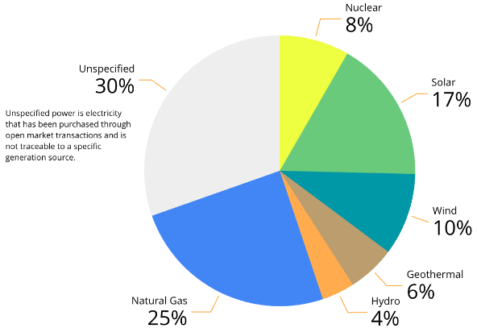
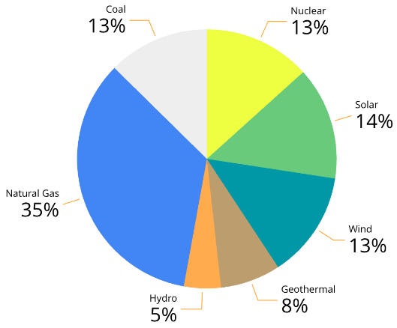
Local Utility Power Content Labels, 2022
Southern California Edison
552 lbs CO₂e/MWh
250 gCO₂e/kWh
LADWP
567 lbs CO₂e/MWh
257 gCO₂e/kWh
Sources: https://sce.com and https://www.ladwp.com/powercontent
Notes:
Let’s break this down to your local utility level. This data is taken from the yearly power content labels. It is essential to understand the carbon content of electricity as we convert from natural gas to electricity.

Slide 17
Average retail price of energy
U.S. Energy Information Agency

Slide 18
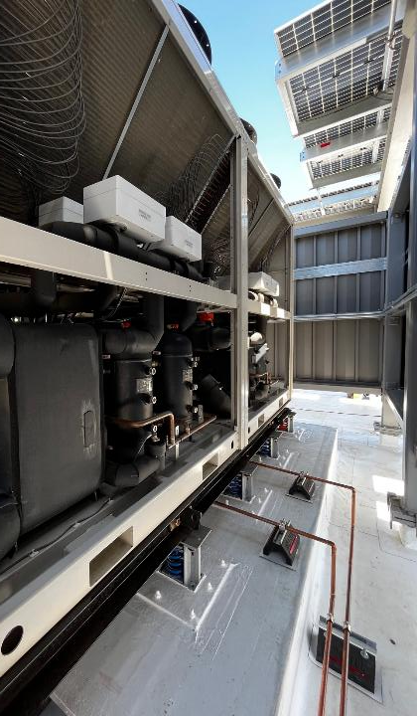
Pillars of Beneficial Electrification
Help the Environment
Energy
Efficiency
Renewable Energy Integration
Improve the Quality of Life
Grid Responsiveness
Save
Money
Reduce overall greenhouse gas emissions
Upgrading buildings to use energy more efficiently
Use of energy generated from renewable sources
Improves IAQ without onsite combustion emissions
Enhancing buildings' ability to respond to grid demands
Potential to reduce building utility costs
Audience
Participation
Notes:
ASK the audience to provide reasons for electrifying buildings before showing the text.

Slide 19
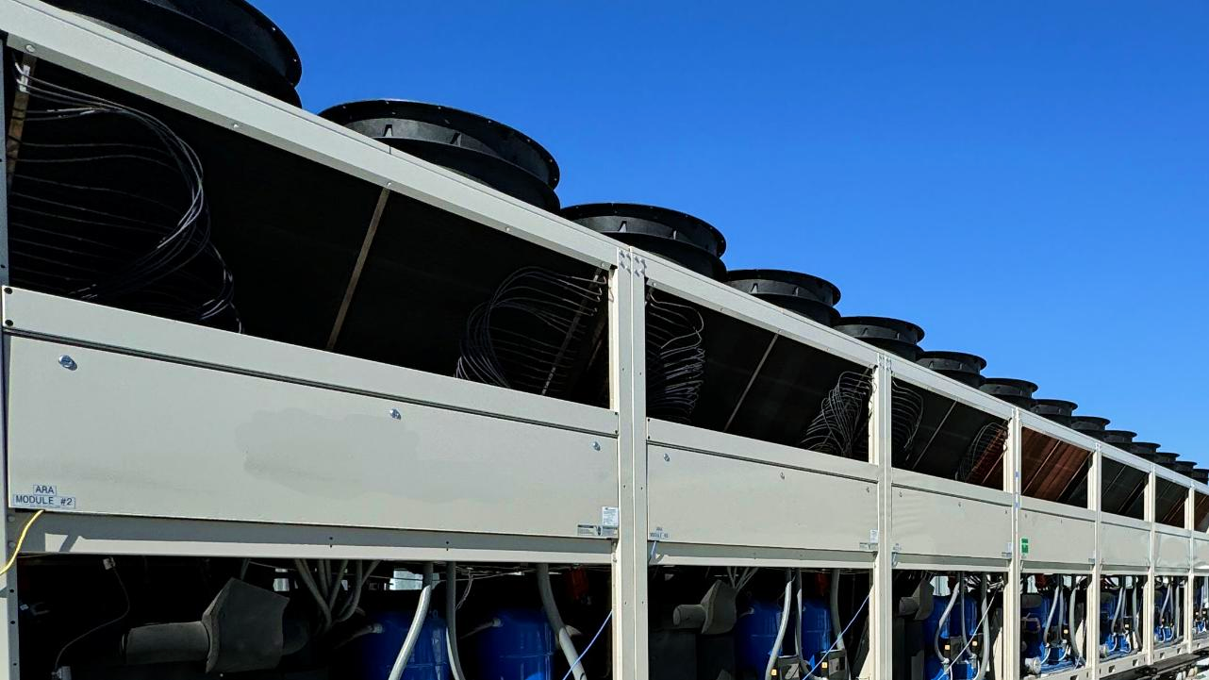
Understanding
Whole Life
Carbon
(WLC)

Slide 20

Building Decarbonization
  whole life = operational
  + embodied

Slide 21
Building lifecycle stages
Source: BS EN 15978:2011
STAGES
PRODUCT
CONSTRUCTION
MAINTAIN AND USE
END OF LIFE
BEYOND THE LIFECYCLE
GHG
EMISSIONS
EMBODIED
CARBON
EMBODIED
CARBON
EMBODIED
CARBON
OPERATIONAL
EMBODIED
CARBON
EMBODIED
CARBON
TIME
RAW MATERIAL TRANSPORT
RAW MATERIAL SUPPLY
END OF LIFE
TRANSPORTATION
MANUFACTURING
TRANSPORT TO SITE
REFURBISHMENT
DECONSTRUCTION
WASTE PROCESSING
REUSE - RECOVERY
CONSTRUCTION
MAINTENANCE
REPLACEMENT
ENERGY USE
WATER USE
REPAIR
DISPOSAL
USE
MODULE
A1
A2
A3
A4
A5
B1
B2
B3
B4
B5
B6
B7
C1
C2
C3
C4
D
Notes:
Lately, there has been a lot of discussion around whole-life carbon emissions based on the life cycle of a building.
As we can see from the left side of this figure, building GHG emissions are locked in place as soon as a building is built, even before its operation
[click] This starts with extract, transport to the factory, and manufacture during the product stage
[click] to the construction stage transporting to the site and constructing the building.
[click] We have both embodied and operational emissions during the maintain and use stage.
The operational carbon is energy and water-related emissions during the use of the building.
Equipment replacements and building renewals add additional embodied carbon during this stage.
[click] It doesn't stop there, we also have embodied emissions at the end-of-life stage due to demolishing the building, hauling away the waste materials, and whether we send it to a landfill or recycle.
[click] The last stage is beyond the lifecycle that covers the emissions for reuse and recovery.
[spend some time on this slide – especially at the end – the idea of a circular economy – remember Edward McDonough – Architecture 2030. He gave our keynote at COP27 this year. Edward wrote a book called Cradle-to-Cradle. The circular economy is the same idea. He used the example of nature and specifically a tree as being one of the most sustainable – self sufficient organisms on the planet. It grows, sheds leaves to feed the microorganisms under it to create its own fertilizer and continues to perpetuate itself year after year. There is no waste in nature – the idea behind the circular economy – no waste – everything is recyclable in some way]
Reducing both embodied and operational carbon in buildings is critical to achieving a more sustainable and low-carbon future.
Governments and other organizations are beginning to understand the importance of evaluating means to reduce embodied and operational emissions.

Slide 22
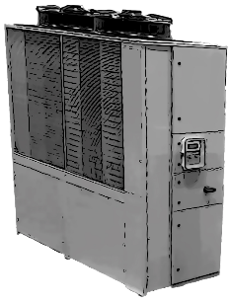
Refrigeration Equipment Greenhouse Gas Emissions
EN 15978
B6: Energy
Operation Carbon
B1: Refrigerant
Embodied Carbon
CO₂e
CO₂e
A1-A5:
Embodied Carbon
CO₂e

Slide 23
Refrigerant Greenhouse Gas Emissions
GHG Emissions =
Refrigerant Charge x Annual Leakage Rate x GWP
  Can calculate it per year in lbs or kg
  Can also calculate it over the life of the building
ASHRAE Fundamentals Handbook Chapter 29, Refrigerants
  Specifies GWP₁₀₀ for various refrigerants using IPCC (2013)
Standard 228 – Standard Method of Evaluating Zero Net Energy and Zero Net Carbon Building Performance
  Specifies annual leakage rates for various system types

Slide 24
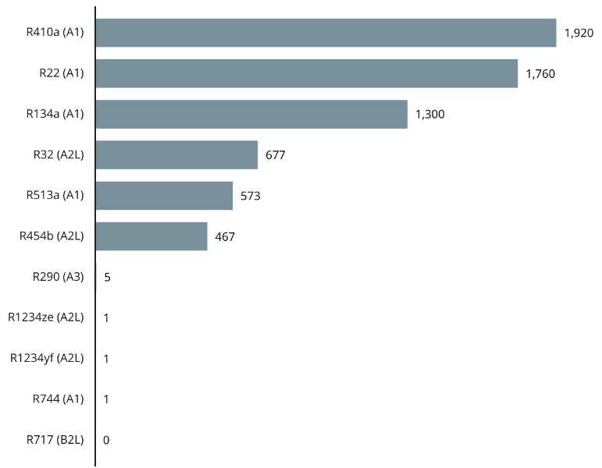
Refrigerant Greenhouse Gas Emissions
GWP of Select Refrigerants, IPCC AR5 (2013)
Propane
*
CO₂
*Breaks down into trifluoroacetic acid (TFA)

Slide 25
Refrigerant Greenhouse Gas Emissions
ASHRAE Standard 228-2023
Typical Annual Refrigerant Leakage Rates by Equipment Type
Equipment Type | Annual Leakage Rate
Water chillers | 5%
Hermetic units | 1%
Rooftop air conditioner | 6%
Residential HP or AC | 2%
VRF | 10%
Commercial condensing units | 15%

Slide 26
Refrigerant Greenhouse Gas Emissions
Reducing Refrigerant Emissions
Use of low-GWP refrigerants
Enhanced energy efficiency
Innovative non-refrigerant technologies
Lower refrigerant volume
Regular maintenance and leak prevention
Refrigerant management and recycling
For ways to reduce refrigerant leakage, refer to REAL Zero booklets at www.realzero.org.uk

Slide 27
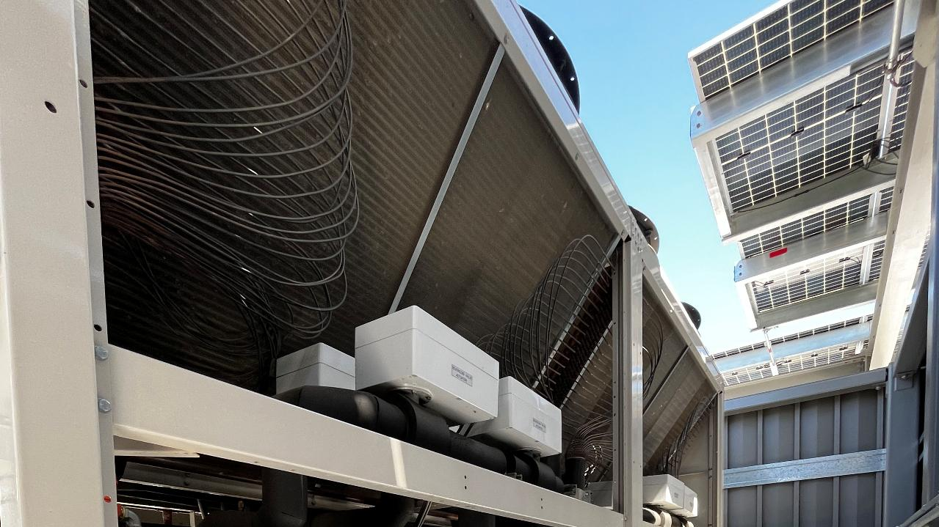
Considering
Decarb Retrofit
Alternatives

Slide 28
Considering
Decarb Retrofit
Alternatives

Slide 29
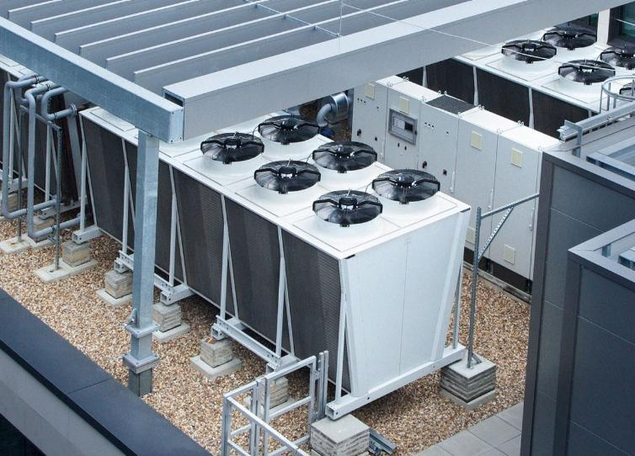
Typical Decarb Retrofit Barriers
Equipment costs
Equipment footprints
Design team expertise
Age of existing buildings
  Electrical capacity
  Service upgrades
Ownership/lease structures
Utility interaction & upgrades
  Wait times, distribution congestion
Power reliability/resilience
Refrigerant embodied carbon

Slide 30


The lens we look through determines what we see…
Simple payback
1:1 equipment replacement
My engineer says, ”It can’t be done.”
Electrify all
at once
Wait for better technology
I have “THE” solution!
Electricity produces emissions
Too
disruptive
Decarb is
not possible
Long term capital planning
Partial electrification and right size equipment
Phase in measures over time
Start with partial electrification
Start now
with enabling steps
There is no “ONE” solution!
Electricity grid is rapidly decarbonizing
Decision tree, phased approach
Decarb is viable

Slide 31


Why not a 1-for-1 replacement?
There is nothing so useless as doing efficiently that which should not be done at all.
Peter Drucker

Slide 32



01
02
03
04
GHG Emissions Reduction
Emission reduction measures
Choose the right set of strategies
Understand how the building operates and set targets
Existing equipment assessment
Selection and Implementation
Analysis and Reporting
On-site Inspections
Data
Collection

Slide 33
UNDERSTAND
Compile building documentation and energy data
Calculate GHG emissions
Set building-level GHG emissions reduction targets
02
GHG Emissions Reduction
01
Existing equipment assessment
Data
Collection
Notes:
Compile building data
As-built drawings
Equipment inventories and cut sheets
Property condition assessments and capital plans
Refrigerant leakage and repair documentation
Prior energy or GHG emission reduction audits (completed within the past five years)
Access to data from a building automation system
Calculate Scope 1 and 2 Emissions
The historical energy consumption data can be used to calculate the building’s Scope 1 and 2 emissions.
The owner and auditor should agree on applicable GHG emissions factors for all energy sources prior to the detailed analysis portion of the audit.
Industry standard emission factors are published by the U.S. Environmental Protection Agency (EPA) and Intergovernmental Panel on Climate Change (IPCC).

Slide 34
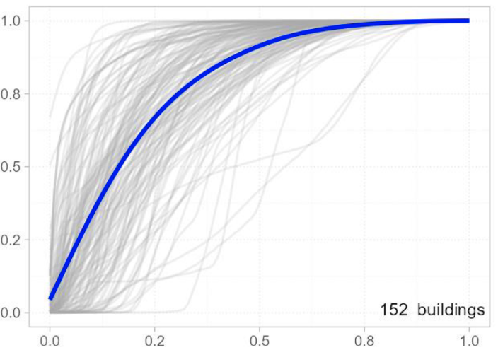
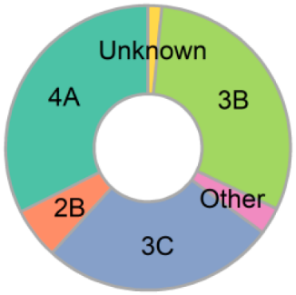
Existing heating hot water system operation
Source: Energy & Buildings, Insights from space heating hot water systems in 259 commercial buildings
Cumulative fraction of operating hours
Buildings in
each climate
Heating load normalized to max

Slide 35
1 kWh/ft²-yr
80% of annual heating energy
consumption occurs when the load
is 25% or less
60-year-old building
125,000 ft² (11,600 m²)
Mild climate
Design 22 Btu/ft² (250 W/m²) peak
Actual 13 Btu/ft² (148 W/m²) peak
Notes:
We should strive to understand existing building annual heating load profiles before replacing boilers with electrical alternatives.
This example shows a 60-year-old building in a mild climate. Two years of trend data show the existing heating system was oversized. This is common with boiler systems.
80% of annual heating therms occur when the load is 25% or less of the installed capacity.
If the system were sized for the peak load experienced, 80% of annual heating therms would occur when the load is 42% or less.
If we are concerned about whole-life carbon, there will not be enough operational carbon savings in the lifetime of the equipment to electrify more than that 50%.
The incremental investment for the additional electrification doesn’t make sense.

Slide 36
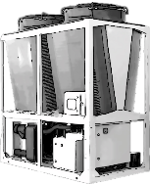



Notes:
If we are concerned about whole-life carbon, there will need to be more operational carbon savings in the lifetime of the equipment to electrify more than 30% of the design load if there is still life left in the existing boilers.
The incremental embodied carbon investment for the additional electrification doesn’t make sense.
We must understand existing building heating load annual profiles to decide how to optimally decarbonize existing hot water systems.

Slide 37
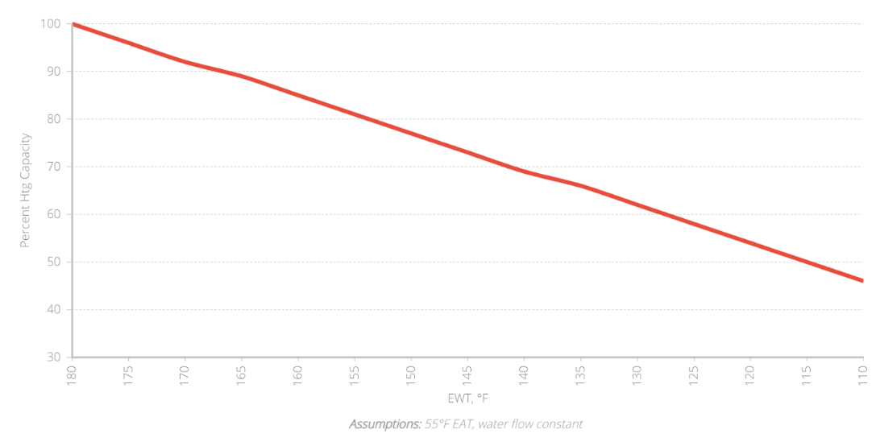
1-row VAV Percent Reheat Capacity vs. EWT
130°F could possibly meet the HHW loads in the previous example without changing piping or reheat coils

Slide 38
UNDERSTAND
Existing equipment assessment
Electrical service capacity
Combustion equipment inventory
On-site renewable energy assessment
GHG Emissions Reduction
02
On-site Inspections

Slide 39
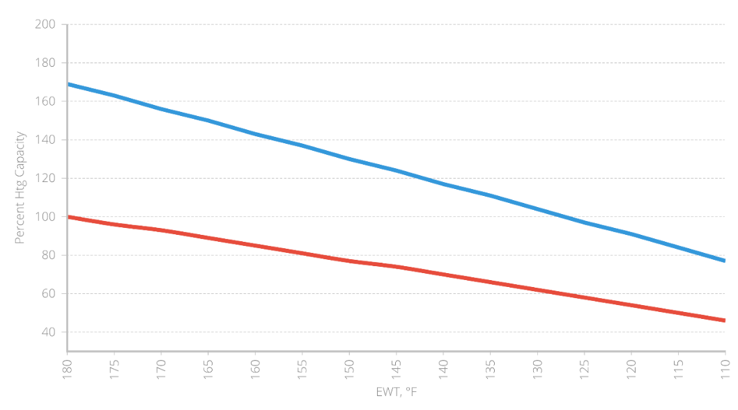

1-row vs. 2-row Reheat Coil Percent Capacity
Assumptions:
55°F EAT, water flow constant
Percent of 180°F EWT
1-row coil capacity

Slide 40
ANALYZE
Emission reduction measures (ERMs)
  Energy efficiency
  Electrification options
  On-site renewable energy
  Fugitive emissions
  Monitoring-based Cx
Future pathway to zero
GHG Emissions Reduction
03
Analysis and Reporting

Slide 41
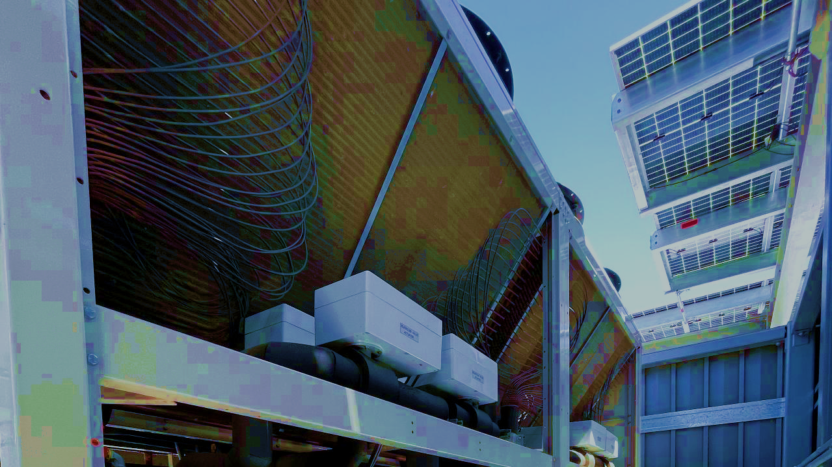
Energy Efficiency 1st!

Slide 42
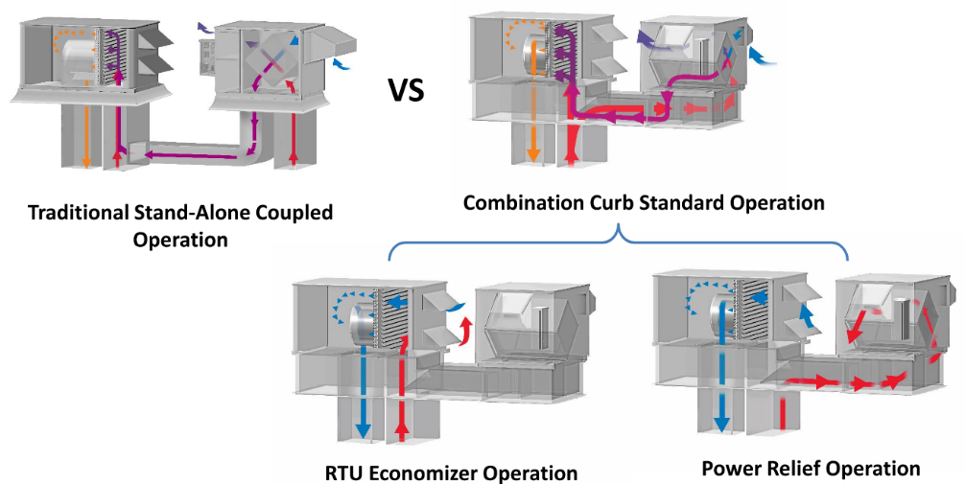
Heat Recovery to Reduce Heating Loads
Ventilation loads are
a substantial portion
of heating loads
55-75%
efficiencies
Source: 2020 ASHRAE Learning Institute Air-To-Air Energy Recovery Applications: Best Practices
Notes:
Air-to-air energy recovery is a very cost-effective and efficient way to recycle waste energy and create superior indoor environments.

Slide 43
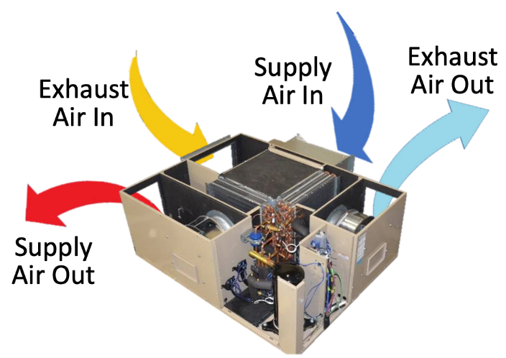
Heat Recovery MA/EA Heat Pumps
Image Source: Transom

Slide 44
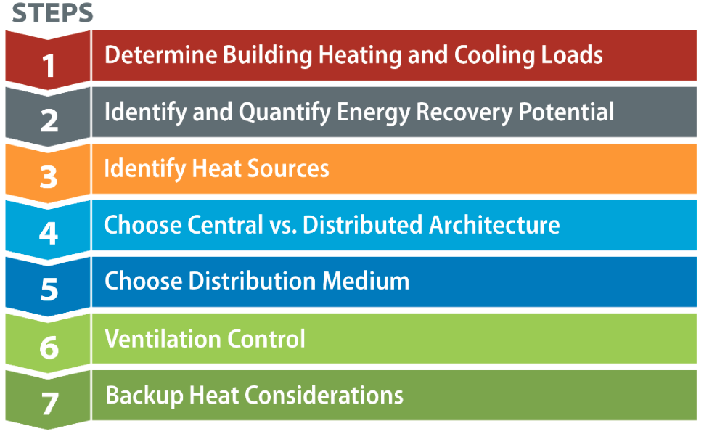
Selecting Retrofit Heat Pump Systems

Slide 45
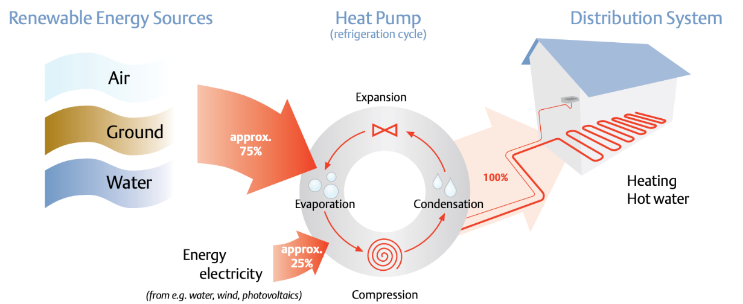
Heat Pump Alternatives
Image Source: Copeland

Slide 46
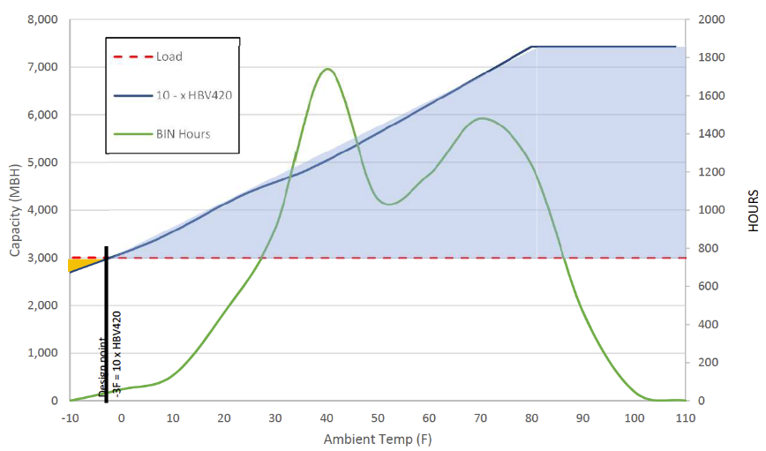
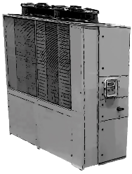
Heat Pump System Sizing, Chicago
Note that overcapacity in the blue area can be as much as 2.5 times the design load
Short cycling compressor runs
Nuisance trip on high-pressure alarms
Load
Capacity
Capacity (MBH)
BIN hours
Hours
Compressor Speed Adjusted
Ambient Temp (°F)
Image Source: Transom
Notes:
The typical winter design point is -5°F ambient
To match the load (3,000 MBH)
Multiple units would be needed
The capacity curve slopes down as ambient temp goes down.
The unit can still operate and produce heat below, but it will add up to the full load.
For this gap back up electric resistance heat is used. See YELLOW area

Slide 47
Long Beach Ambient Temperature TMY3
Heating system turndown ratios have always been important for stable control.
Heat pumps don’t change that requirement!

Slide 48
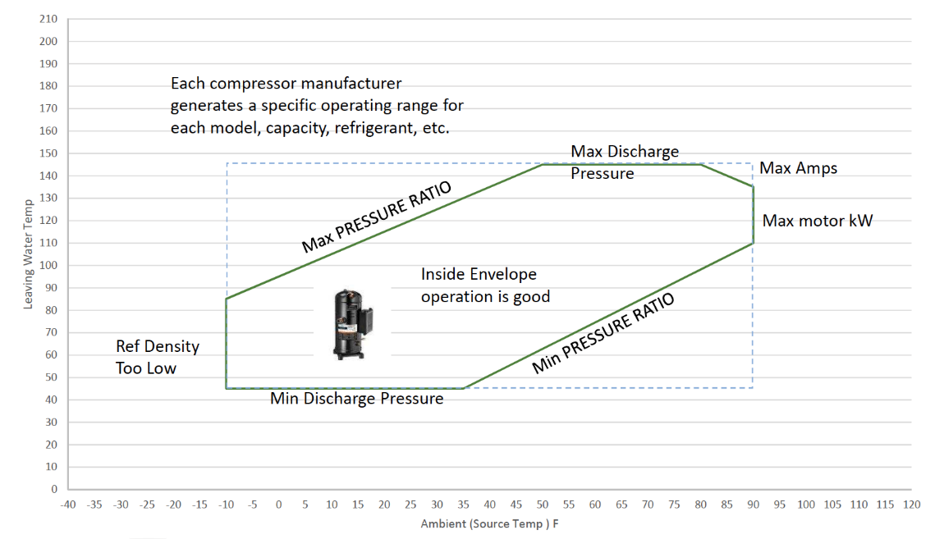
Understand the Operating Limits for ASHPs
Image Source: Transom

Slide 49
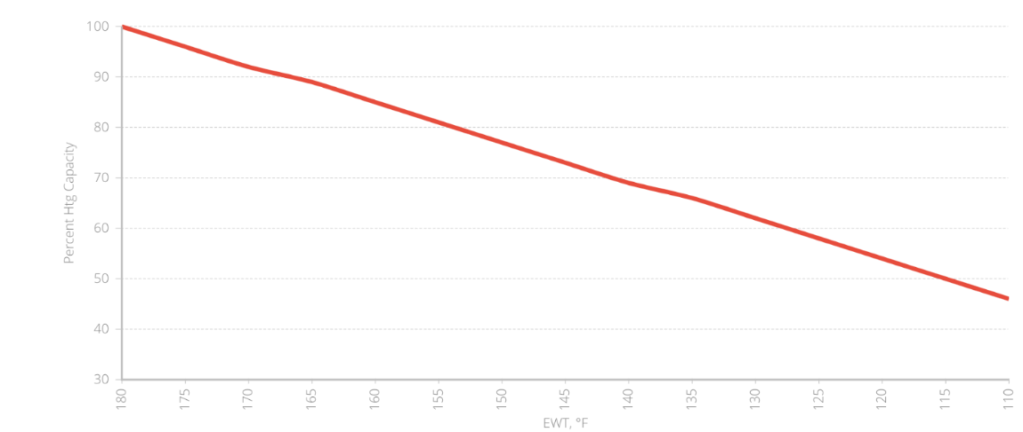
Lower Supply Water Temperatures
Reimagine HHWS Temperature Regimes
Medium Efficiency Equipment
Fewer Equipment Options
Highest Efficiency Equipment
Most Equipment Options
Terminal Device Heating Capacity
Lowest Efficiency Equipment
Nearly No
Equipment Options
Low Efficiency Equipment
Few
Equipment Options
Supply Water Temperature °F

Slide 50
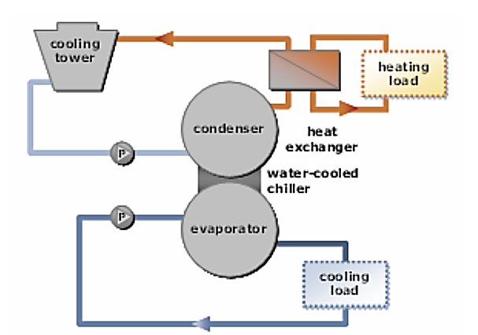
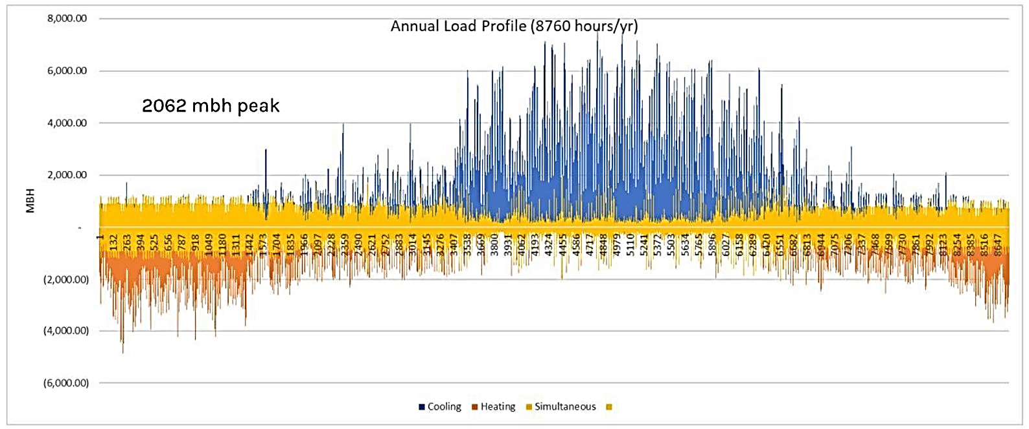
Heat/Energy Recovery
(Waterside)
Source: Image Courtesy SmithGroup

Slide 51
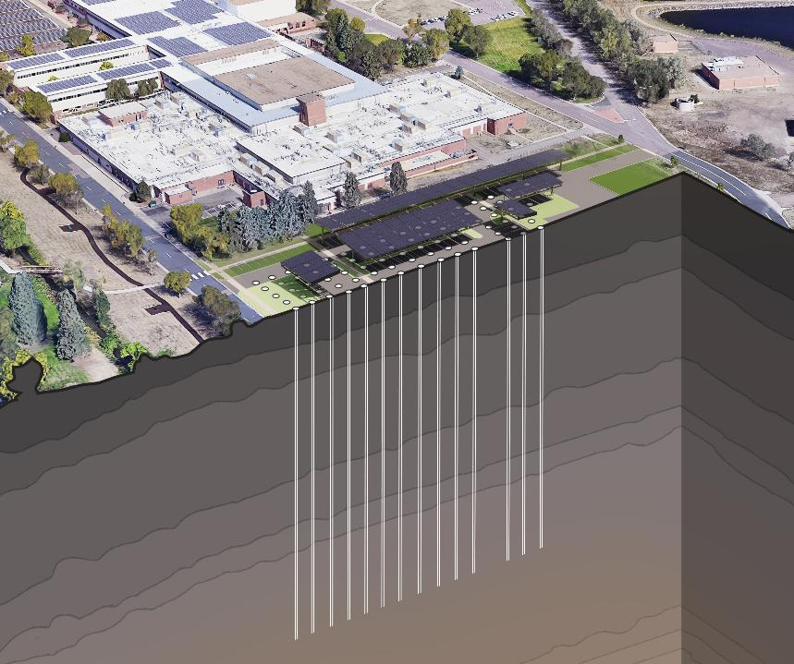
Right-Sourcing
(GSHP)
Source: Image Courtesy SmithGroup

Slide 52
OPTIMIZE
GHG Emissions Reduction
04
Evaluate optimal near-term solution strategies
Costs do matter!
This is a journey by 2050
Selection and Implementation

Slide 53
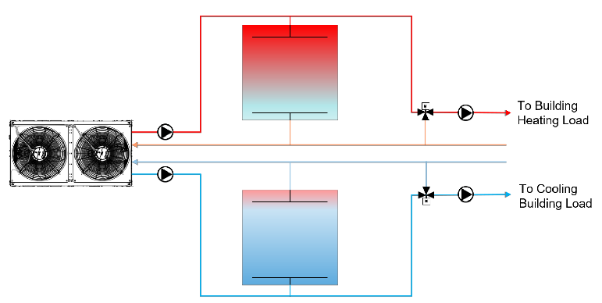
Advanced Heat Pump Strategies
(Pairing with Storage)
Source: Image Courtesy of SmithGroup

Slide 54
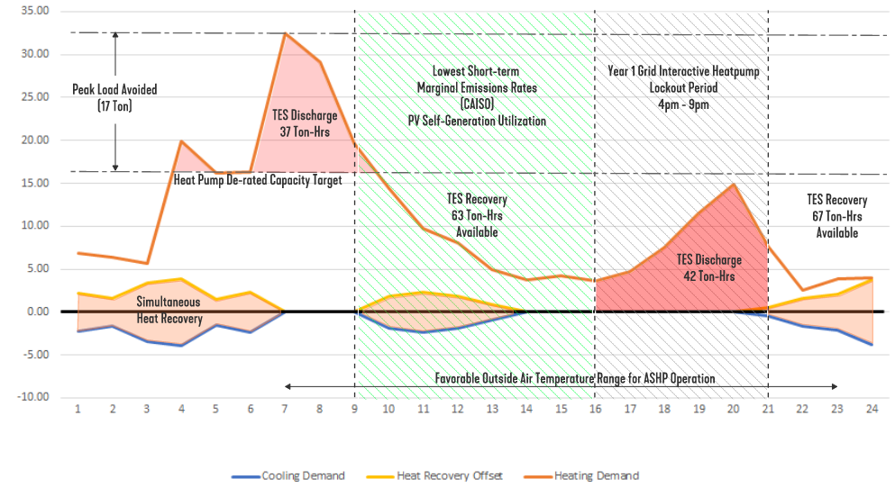
Thermal energy storage potential

Slide 55
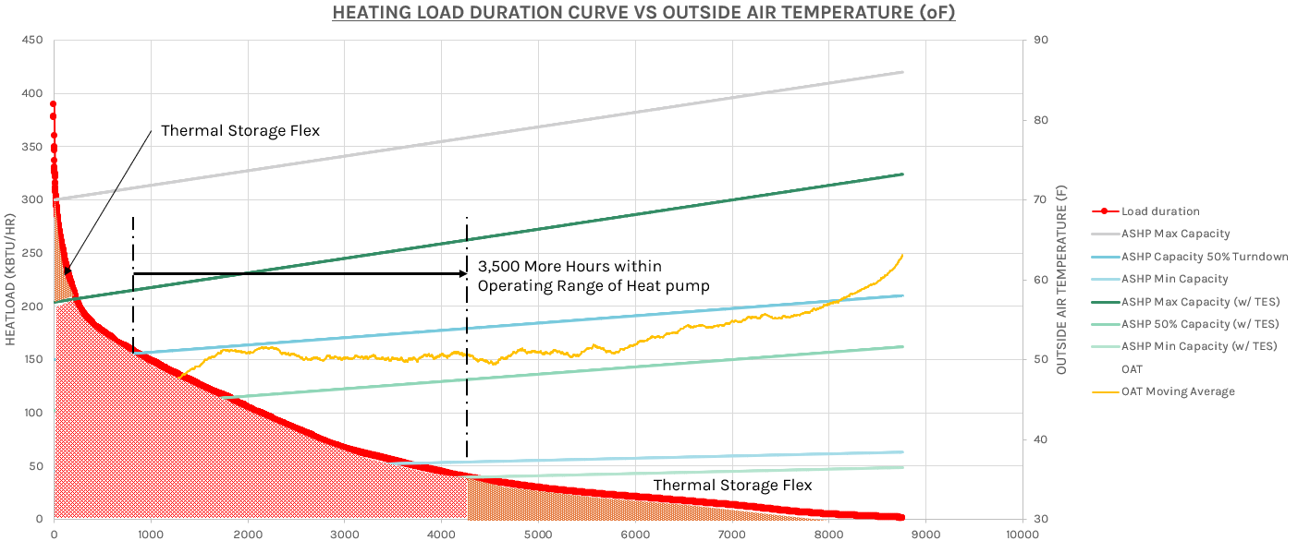
Thermal energy storage potential

Slide 56
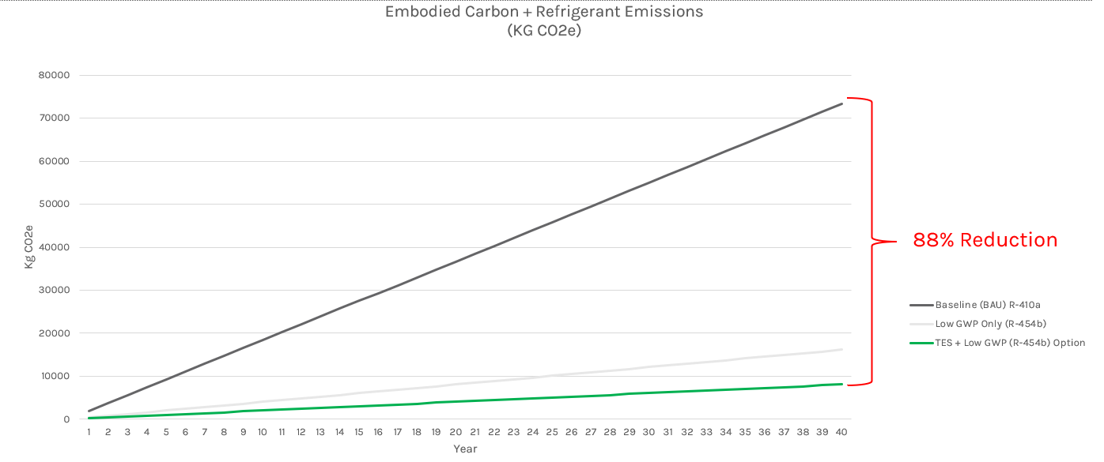
Thermal energy storage potential

Slide 57
Decarb
Retrofit
Lessons
Learned
All GHG emissions matter (operational, embodied, and B1 refrigerants)
Decarbonization retrofits must reduce whole life GHG emissions

Slide 58
Determine actual peak heating loads and load profiles when decarbonizing existing heating systems
NEVER replace the same size equipment without first determining the actual needs of the existing building
Decarb
Retrofit
Lessons
Learned

Slide 59
Decarb
Retrofit
Lessons
Learned
There is a paradigm shift in the cost-effectiveness of heat recovery technologies with all-electric buildings
Building envelope and heat recovery options that were not cost-justified with boilers are now often economical with electrification retrofits.

Slide 60
Use minimum 2-row reheat coils when designing terminal reheat systems today
The future is low-temperature hot water to improve energy efficiency and exergy
Decarb
Retrofit
Lessons
Learned

Slide 61
Thermal storage is our ally (technical and economical) when providing heating solutions with hydronic heat pumps
Turndown ratios still matter in heating system design
Decarb
Retrofit
Lessons
Learned

Slide 62
Decarb
Retrofit
Lessons
Learned
Don’t be afraid of partial decarbonization strategies for meeting life cycle cost requirements
An 80% GHG emission reduction is better than NO reduction!

Slide 63


Center of Excellence for Building Decarbonization (CEBD)
Four Key Areas
Focused on strategy, thought leadership, industry collaboration, and public advocacy related to building decarbonization
Works with the ASHRAE councils to deliver projects
  Technology
  Education
  Research
  Standards

Slide 64
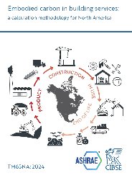
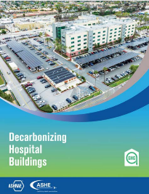




ASHRAE Published Decarbonization Guides

Slide 65


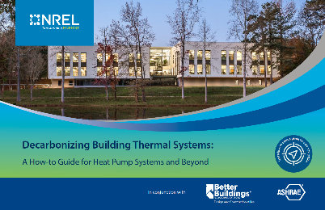
ASHRAE Decarbonization Guides
COMING IN 2025!
Expanded Version 2

Slide 66

Notes:
I will leave you with one thought: We can do better and develop solutions that minimize our impact on the environment.

Slide 67


Thank You

